Slide 1


INSAID – EDA Project
IMDb 1000 Movies Dataset
Present By:
Mohammed Abrar Khalandar

Slide 2
Outline
Problem statement and approach
Data description and loading
Data profiling
Deriving best Genre, Actors and Directors based on their Movies Revenue, Ratings and Metascore
Conclusion

Slide 3
Problem statement and approach
A Production needs to take a decision for movie production based on IMDb dataset.
The dataset consists of 1000 Movies of data.
In order make a right decision the production company should choose the best Genre, Actors and Director for the Movies success.
We shall now see how Actors, Director and the Genre is chosen based on their Revenue(Millions), Rating and Metascore

Slide 4
Data description and loading
The Dataset is derived from IMDb which consists of 1000 movies from year 2006 to 2016
The Dataset consists of information such as Movie Title, Genre, Director, Actors, Ratings, Revenue etc.
The Dataset Comprises of 1000 rows and 12 columns

Slide 5
Datasets Columns description
Columns | Description
Rank | Ranking of Movies
Title | Title of the film
Genre | List of genres to classify the Movies
Description | Brief summary of the Movies
Director | Movies Directors
Actors | Main Actors of the Movies
Year | Release year of the Movies
Runtime (Minutes) | Duration of the film in minutes
Rating | User ratings for the movie 0-10
Votes | Number of votes
Revenue (Millions) | Movies revenue in millions
Metascore | Average of critic scores from 0-100

Slide 6
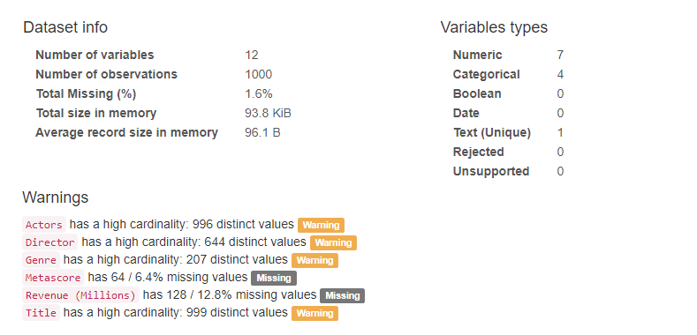
Data profiling
Pre-Profiling

Slide 7
Data profiling
Pre-Processing
Metascore has 6.4% missing values and hence we fill up the missing data with Mean values grouped by year
Revenue (Millions) has 12.8% missing values and hence we fill up the missing data with Mean values grouped by year

Slide 8
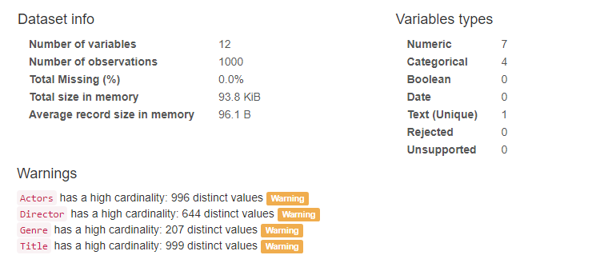
Data profiling
Post - Processing

Slide 9
Deriving Top Genre, Actors and Directors based on their Movies Revenue, Ratings and Metascore
Years in which Movies Revenues had a rise?
Years in which the Movies Ratings had a rise?
Years in which the Movies Metascore had a rise?

Slide 10
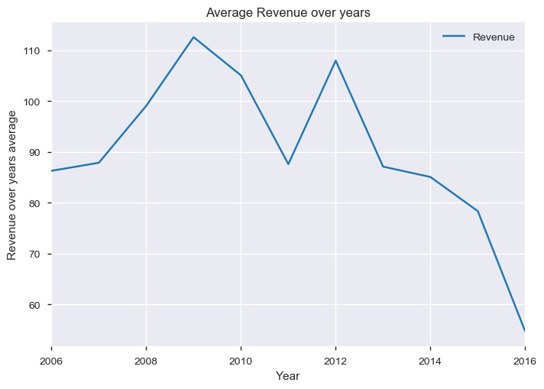
Years in which Movies Revenues had a rise
Years 2009 and 2012 has the best Revenue generated in the years 2006 - 2016

Slide 11
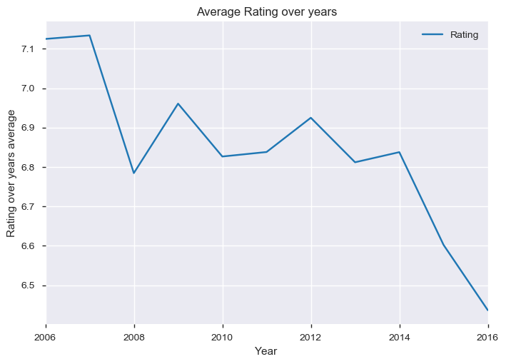
Years in which the Movies Ratings had a rise
Years 2007, 2009 and 2012 had the best Average ratings for Movies in the years 2006 - 2016

Slide 12
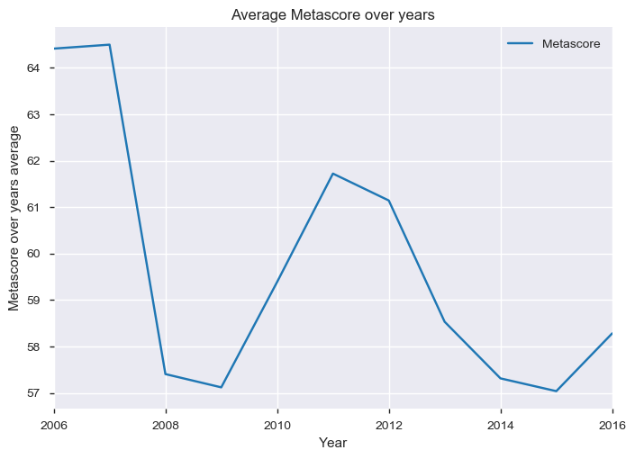
Years in which the Movies Metascore had a rise
Year 2007 and 2011 had the best average Metascore in years 2006 - 2016

Slide 13
Deriving best Genre from the Dataset

Slide 14
Which are the top most Genres in years where the Movies Revenue had a rise?
Which are the top most Genres in years where the Movies Ratings had a rise?
Which are the top most Genres in years where the Movies Metascore had a rise?
Which are the top 10 Genres based on Revenue, Ratings and Metascore?

Slide 15
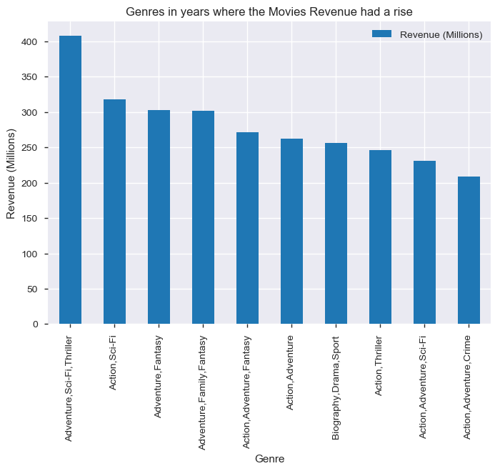
Which are the top most Genres in years where the Movies Revenue had a rise
As years 2009 and 2012 had the highest revenue, Movies with Genre combination Adventure, Sci-Fi, Thriller tops the chart based on Revenue (Millions)

Slide 16
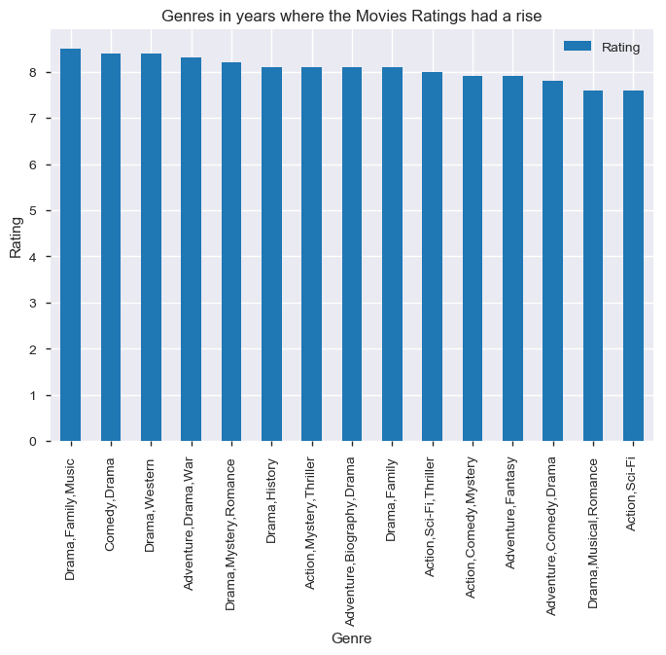
Which are the top most Genres in years where the Movies Ratings had a rise
As years 2007, 2009 and 2012 had the highest Rating, Movies with Drama, Family, Music tops the chart based on ratings

Slide 17
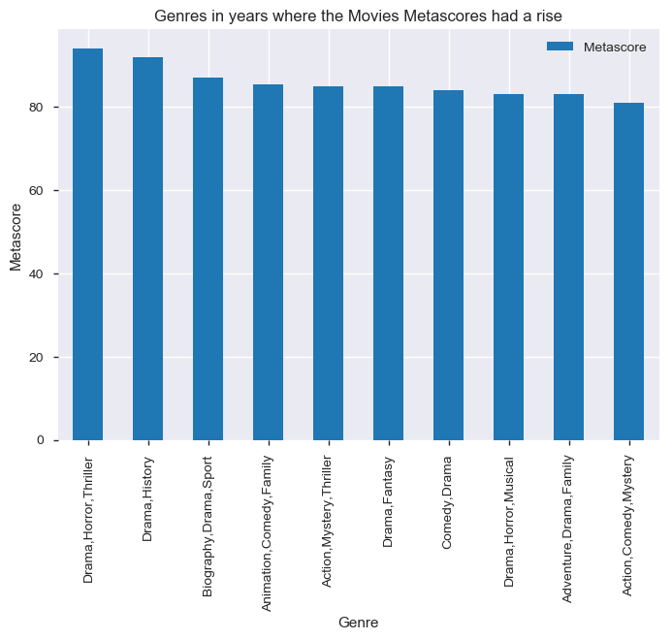
Which are the top most Genres in years where the Movies Metascore had a rise
As years 2007 and 2011 had the highest Metascore, Movies with Genre Combination Drama, Horror and Thriller tops the chart based on Metascore

Slide 18
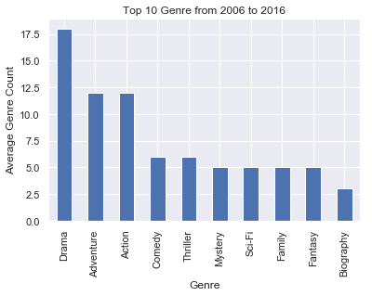
Which are the top 10 Genres based on Revenue, Ratings and Metascore
Top 10 Genres based on Revenue, Ratings and Metascore

Slide 19
Deriving best Actors from the Dataset

Slide 20
Which are the top most Actors in years where the Movies Revenue had a rise?
Which are the top most Actors in years where the Movies Ratings had a rise?
Which are the top most Actors in years where the Movies Metascore had a rise?
Which are the top 10 Actors based on Revenue, Ratings and Metascore?

Slide 21
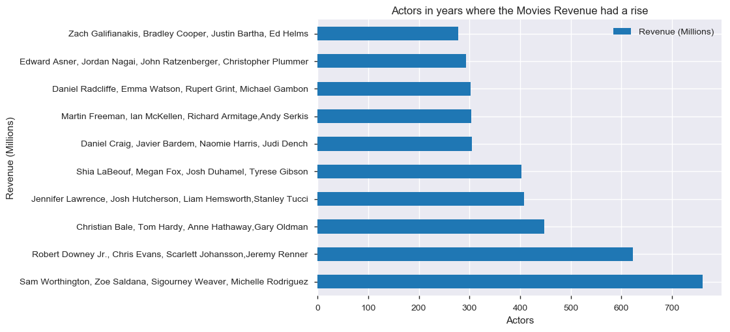
Which are the top most Actors in years where the Movies Revenue had a rise?
As years 2009 and 2012 had the highest revenue, Movie with combination Sam Worthington, Zoe Saldana, Sigourney Weaver, Michelle Rodriguez tops during period (2006 - 2016)

Slide 22
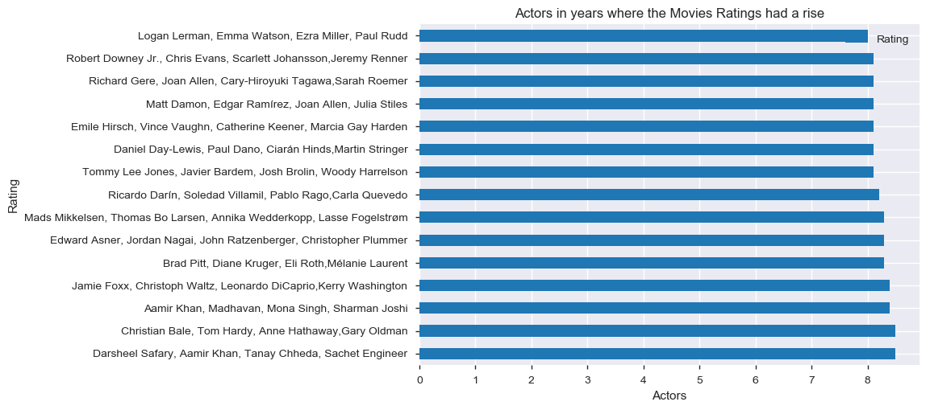
Which are the top most Actors in years where the Movies Ratings had a rise
As years 2007, 2009 and 2012 had the highest Rating, Actors with combination:
1. Darsheel Safary, Aamir Khan, Tanay Chheda, Sachet Engineer
2. Christian Bale, Tom Hardy, Anne Hathaway, Gary Oldman tops during the period (2006 - 2016)

Slide 23
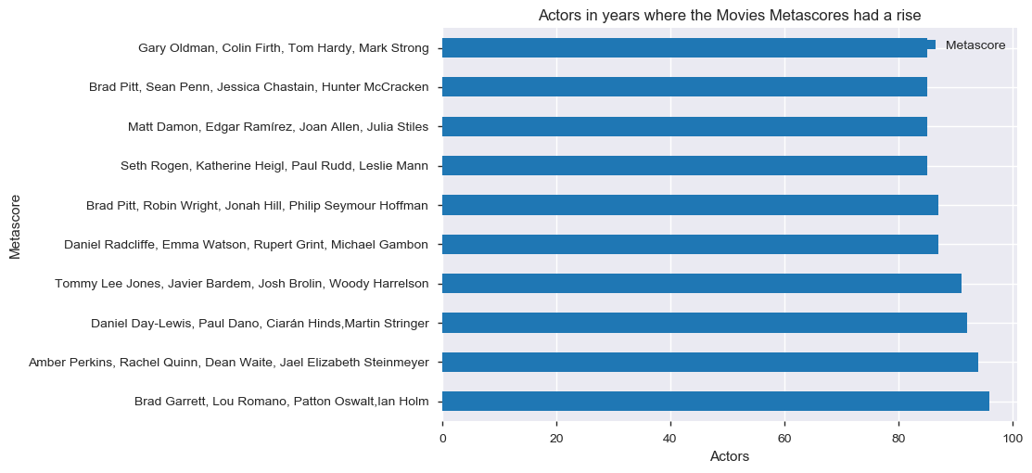
Which are the top most Actors in years where the Movies Metascore had a rise
As years 2007, and 2011 had the highest Metascore, Actors with combination:
Brad Garrett, Lou Romano, Patton Oswalt, Ian Holm tops during the period (2006 - 2016)

Slide 24
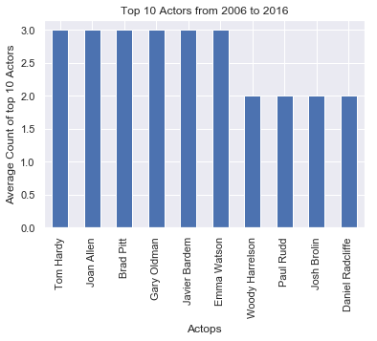
Which are the top 10 Actors based on Revenue, Ratings and Metascore
Top 10 Actors based on Revenue, Ratings and Metascore

Slide 25
Deriving best Director from the Dataset

Slide 26
Which are the top most Director in years where the Movies Revenue had a rise?
Which are the top most Director in years where the Movies Ratings had a rise?
Which are the top most Director in years where the Movies Metascore had a rise?
Which are the top 10 Director based on Revenue, Ratings and Metascore?

Slide 27
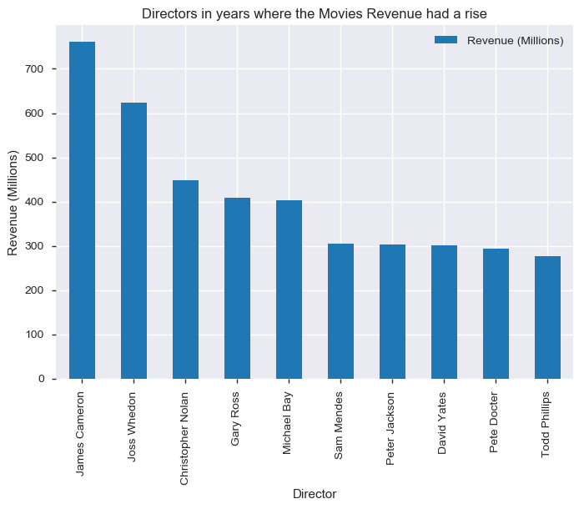
Which are the top most Director in years where the Movies Revenue had a rise
As years 2009 and 2012 had the highest revenue, Movies directed by James Cameron tops the chart

Slide 28
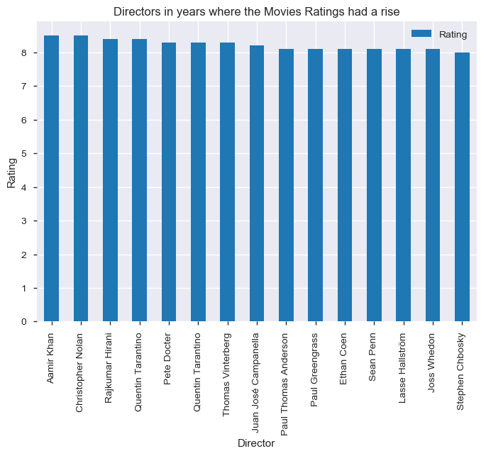
Which are the top most Director in years where the Movies Ratings had a rise
As years 2007, 2009 and 2012 had the highest Rating, Director Aamir Khan tops the chart based on Rating

Slide 29
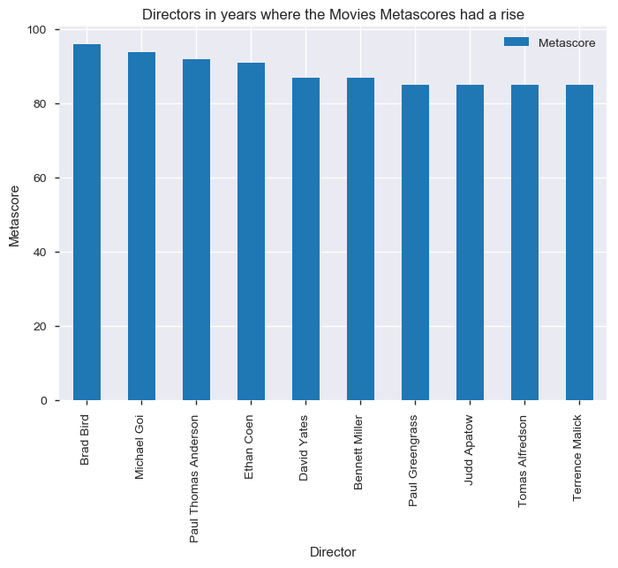
Which are the top most Director in years where the Movies Metascore had a rise
As years 2007 and 2011 had the highest Metascore, Brad Bird tops the chart as best director based on Metascore

Slide 30
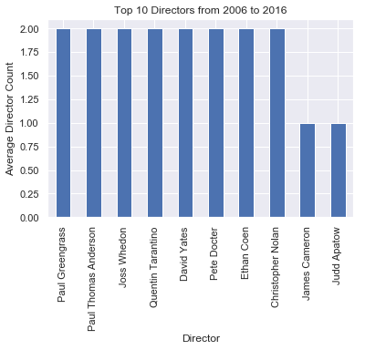
Which are the top 10 Director based on Revenue, Ratings and Metascore
Top 10 Directors based on Revenue, Ratings and Metascore

Slide 31
Conclusion
Drama
Adventure
Action
Comedy
Thriller
Mystery
Sci-Fi
Family
Fantasy
Biography
Tom Hardy
Joan Allen
Brad Pitt
Gary Oldman
Javier Bardem
Emma Watson
Paul Greengrass
Paul Thomas Anderson
Joss Whedon
Quentin Tarantino
David Yates
Pete Docter
Ethan Coen
Christopher Nolan
Best Actors
Best Genre
Best Directors
Movie production with above Genre combination, Actors and Director should yield production company a good result

Slide 32
Thank You

